Slide 1

Flappy Pidgeon
{ Feel free to insert images here or delete }
N315 – Project One
Jake Terry
09/25

Slide 2
Discussion 1
The goal is to create flappy birds like game.
Players will control a pidgeon that has to fly inbetween obstacles.
A score is incremented for each successful obstacle passed.
Obstacles will be of varying height and gradually move faster.

Slide 3
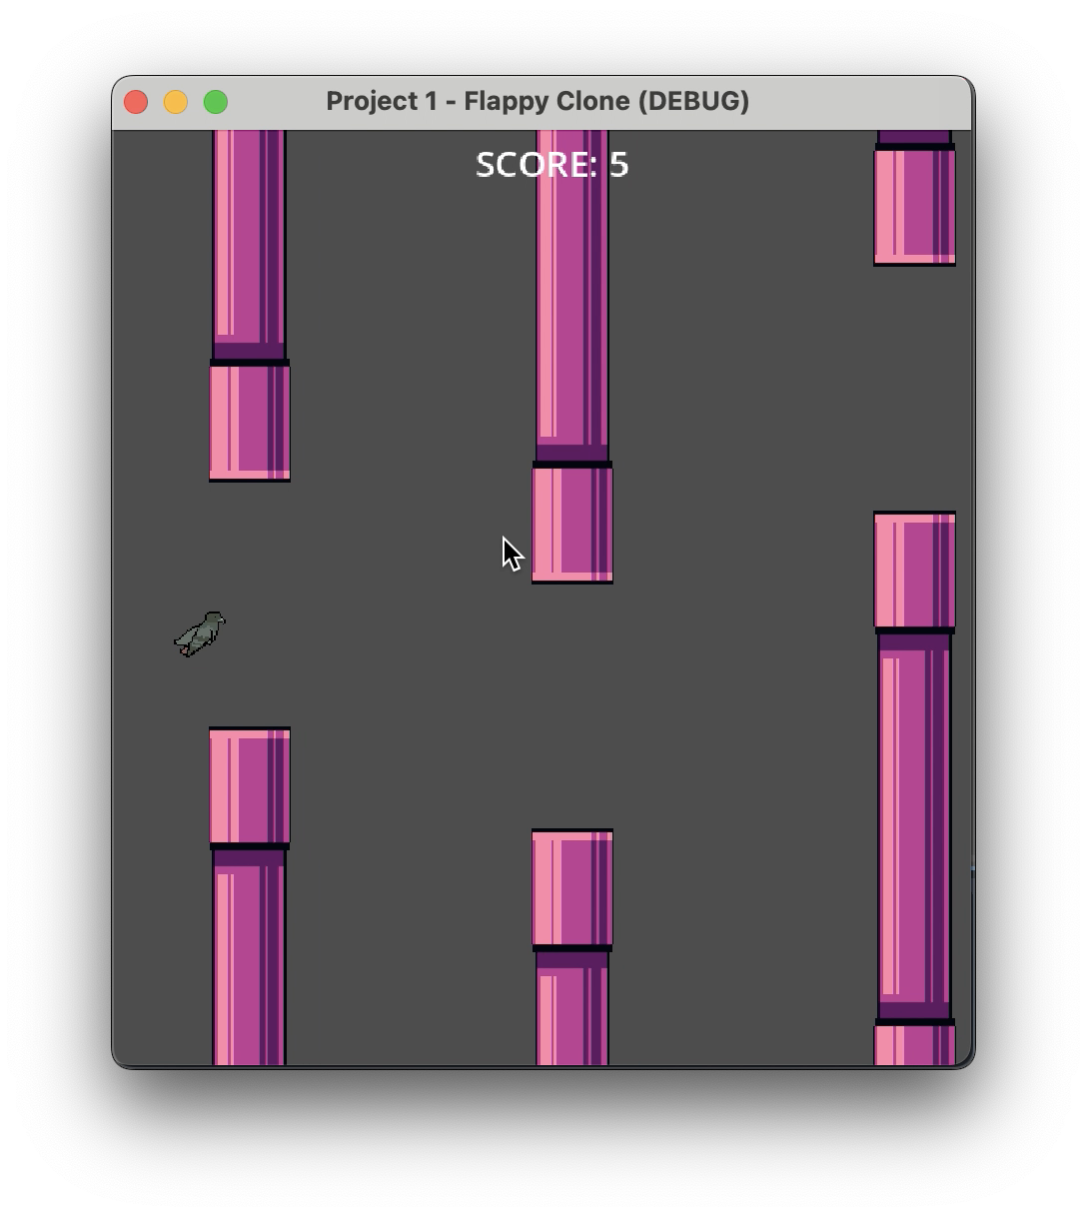
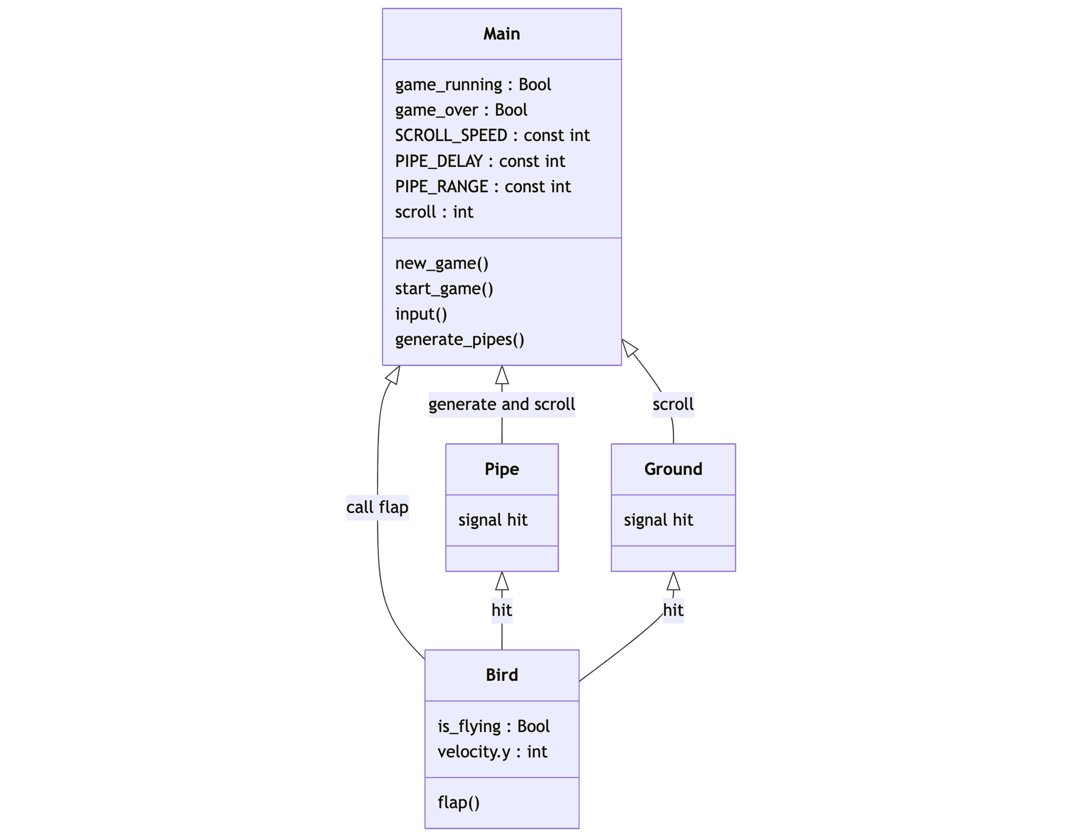
Discussion 1 – Screenshot / image

Slide 4
Discussion 1 – Question
What is something you are struggling with in your game?
Getting the gdscript shader to pause when the game stops.
When the gdscript DOES pause, it reverts to its beginning state, looking very jarring all of a sudden.
How to increase the speed of the pipe generation over time.
How to create a start, quit, and restart button.
When I restart the game, the pipes do not despawn.

Slide 5
Discussion 1
Have a peer / group look through your code and comment on
Pipes could be two different nodes, one for the top and one for the bottom. That way you can vary how the pipes spawn so it is not always in pairs.
Lots of variables defined in main, maybe could use a global node to hold them for organization.
Folder structure setup well, with folders for scripts, scenes, and assets.

Slide 6
Discussion 1
Learned how to use buttons, so next focus will to get working menu and restart icons.
Figure out how to pause the background shader at its exact position when the player collides or goes out of bounds.
Clean up my code by writing some comments for the parts that are not self explanatory.

Slide 7
Discussion 1 –Reflection
Didn’t know about gdscript shaders until I was trying to figure out how to do parallax. Seems parallax requires a Camera node but my game doesn’t use one and that led me to gdscripts and how you can use them as material for Sprites or TextureRects.
The background animation is from an asset on itch.io and it came with a built in gdshader script that I will have to modify to pause like I need it to.

Slide 8
Discussion 1 –Self Assessment
Bold your self-assessment on the following areas
Project progress poor acceptable excellent
Variable naming poor acceptable excellent
Debugging / problem solving poor acceptable excellent
Godot exploration poor acceptable excellent
Polish plans poor acceptable excellent

Slide 9
Discussion 2
Focus on making a moving ground that is also a collision object.
Adjust pipe spawning range, and speed.
Employ an elapsed time metric to store the position of my background shader when it stops.
I actually need a camera node, because when you go full screen the game renders parts outside the viewport when it shouldn’t.

Slide 10
Discussion 2 – Screenshot / Image
ULM
BACKGROUND SHADER

Slide 11
Discussion 2 - Question
What is something you are struggling with in this project?
It takes me a lot longer to find a good sprite that works well with the project than actually implementing the sprite into the project.
I was using input to control how to start the game, now I am trying to understand how to implement buttons that call different methods based on the signal emitted.
The moving ground isn’t looping seamlessly but it is becoming too much of a headache to nitpick over.

Slide 12
Discussion 2 -
Delete and replace with summary bullet points about the aesthetics of your game:
I need to balance the span between the top and bottom of the pipe in order to make the game challenging but not impossible. Adjusting the speed of the pipes makes the game harder.
I am going for a synth city vibe and the pidgeon fits the theme as a city bird.
I am satisfied with the movement of my game, the flap function works as intended and feels responsive.

Slide 13
Discussion 2 –Reflection
Delete and add your own reflection on
It is easy to group items based on their file extension. Being able to find the script you need to adjust quickly is a must.
I used a lot of signals to make connection between objects in Godot. If a pipe or ground detects a body on entered, it emits a signal, that signal calls a method in another object if emitted.

Slide 14
Discussion 2 – Self Asssessment
Bold your self-assessment on the following areas
Project progress poor acceptable excellent
Variable naming poor acceptable excellent
Debugging / problem solving poor acceptable excellent
Godot exploration poor acceptable excellent
Polish plans poor acceptable excellent

Slide 15
P1 – Final Reflection
Screenshot of final product here

Slide 16
P1 – Final Reflection
Technique
The control flow of my program is like this: New Game -> Start Game -> clears all objects, resets bird pos, reset score -> check if_falling -> Game Over -> Quit
I use condition blocks to check if the game is running, if the game is over, if the bird is flying, and if the bird is falling. This allows me to control the flow of the game and make it respond to other entities.
Aesthetics
My game is very…purple. Wasn’t my intention however I love the synth city vibe and it ended up working out in my opinion. It is hard to see the pidgeon however.
Major concepts learned
I learned about gdshader scripts, am more comfortable with signals and collision shapes, as well as grouping and instantiating other scenes inside of a separate scene.

